Slide 1
Lending Club Case Study
Anish Kumar Dubey

Slide 2
Business Objectives
Consumer Finance Company is the largest online loan marketplace, facilitating personal loans, business loans, and financing of medical procedures. Borrowers can easily access lower interest rate loans through a fast online interface.
Credit loss is the amount of money lost by the lender when the borrower refuses to pay or runs away with the money owed. In other words, borrowers who default cause the largest amount of loss to the lenders. In this case, the customers labeled as 'charged-off' are the 'defaulters'.
Identification of such applicants using EDA is the aim of this case study.

Slide 3
Business Understanding
When the company receives a loan application, the company has to make a decision for loan approval based on the applicant’s profile.
Two types of decisions that could be taken by the company:
Loan accepted : If the company approves the loan, there are 3 possible scenarios described below:
Fully paid: Applicant has fully paid the loan (the principal and the interest rate).
Charged-off: Applicant has not paid the installments in due time.
Current: Applicant is in the process of paying the installments.
Loan rejected: The company had rejected the loan because the candidate does not meet their requirements etc.
Two types of risks are associated with the bank’s decision:
Applicant is likely to repay the loan - Not approving the loan results in a loss of business to the company.
Applicant is not likely to repay the loan - Approving the loan may lead to a financial loss for the company.

Slide 4
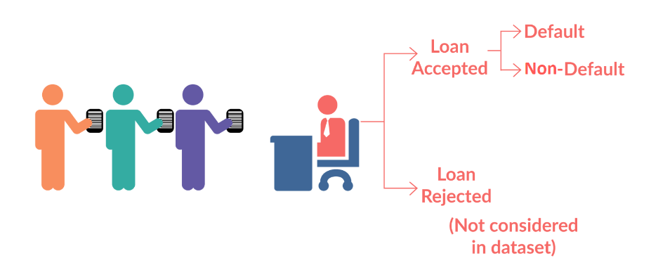
Business Understanding
Loan Dataset
Exploratory data analysis
Sourcing Data
Data Cleaning
Univariate Analysis
Bivariate Analysis
Insight
Recommendations

Slide 5
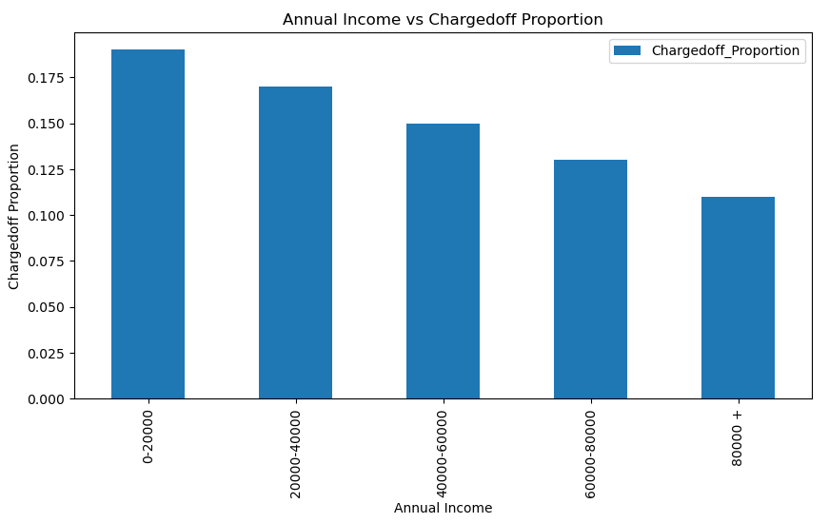
Income range 80000+ has less chances of charged off.
Income range 0-20000 has high chances of charged off.
Notice that with increase in annual income charged off proportion got decreased.

Slide 6
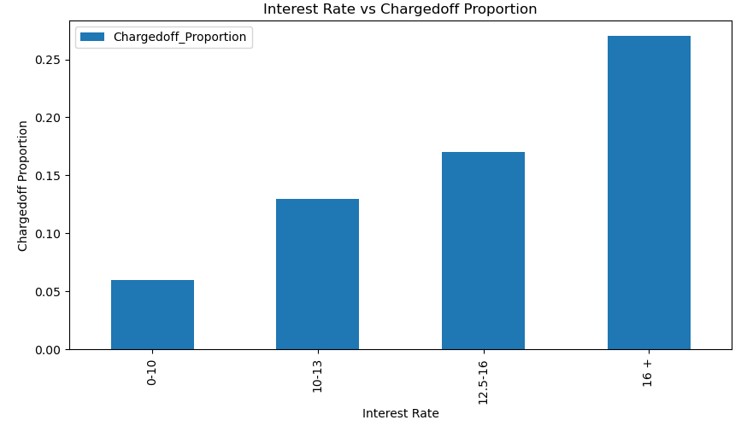
Interest rate less than 10% has very less chances of charged off.
Interest rate more than 16% has good chances of charged off.
Notice that with increase in interest rate charged off proportion got increase.

Slide 7
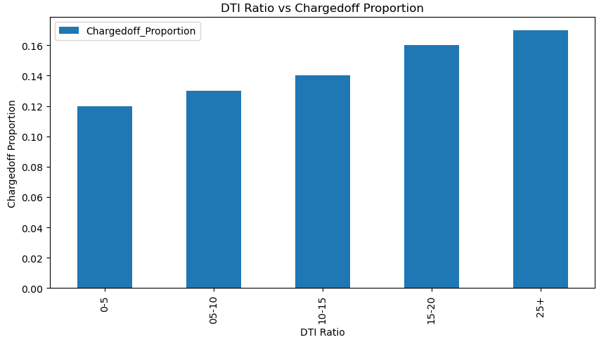
DTI ratio less than 5 has very less chances of charged off.
DTI ratio more than 25 has good chances of charged off.
Notice that with increase in DTI ratio charged off proportion got increase.

Slide 8
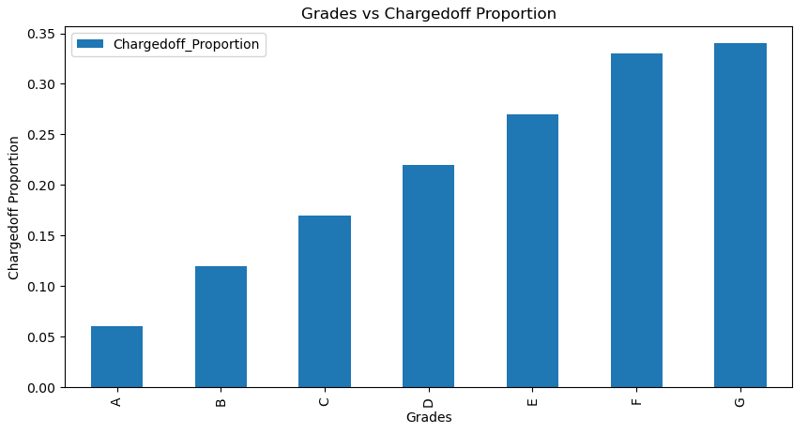
Grade "A" has very less chances of charged off.
Grade "F" and "G" have very high chances of charged off.
Notice that Chances of charged off is increasing with grade moving from "A" towards "G".

Slide 9
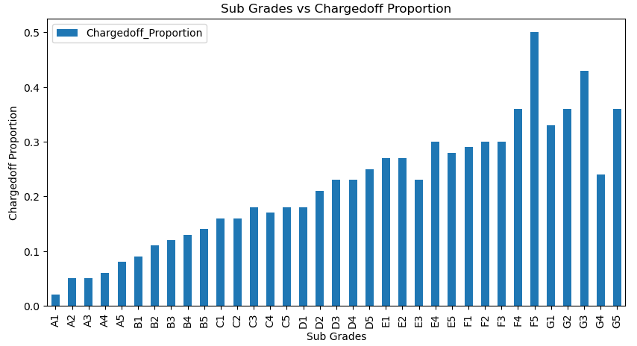
Similarly Grades :
Sub Grades of "A" has very less chances of charged off.
Sub Grades of "F" and "G" have very high chances of charged off.
proportion of charged off is increasing with sub grades moving from sub grades of "A" towards sub grades of "G"

Slide 10
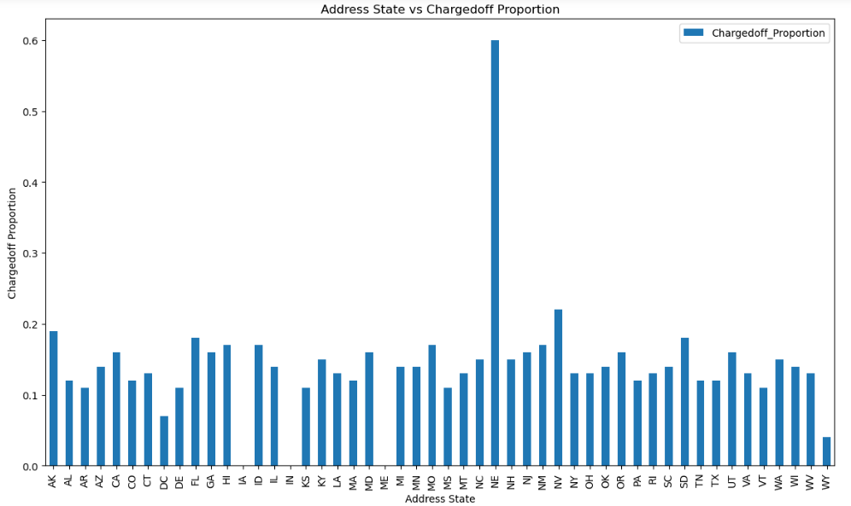
NE state has high chance of charged off. ME, IN & IA also has zero chance of charged off but we can not make any decisions based on this because number of applications are also in these state.
CA, NY, FL & TX has good number of applications and charged offs.

Slide 11
